Slide 1








A 2-days National Level Hackathon on
AI in education
POLYGLOT AI
Team Name - THE PROTECTORS
Name of Leader- Arman Ansari
Date of submission- 05/09/25
College Address-Sagar Institute of Research & Technology (Bhopal)
www.samadhan.sistec.ac.in/

Slide 2


AREA OVERVIEW
This project falls under AI in Education (AIED), a part of Educational Technology (EdTech).
It focuses on using Artificial Intelligence tools to assist in assessment and evaluation of students.
Such tools make education more personalized, efficient, and data-driven.
AI-powered assessment systems help students by reducing manual workload, giving instant solution, and identifying learning process of students.
IMPORTANCE OF AREA
We chose this area because AI can transform education by making assessment more accurate, fast, and student-friendly, which directly improves the quality of learning.

Slide 3
Preliminary Solution Concept
Problem Statement:
Traditional writing and review methods are time-consuming and language-restricted. Students face challenges like:
Difficulty in understanding lengthy content.
Barriers in cross-language communication.
Limited opportunities for peer collaboration and review.

Slide 4
Proposed Idea / Solution:
Develop PolyglotAI, an application that:
This platform offers features such as:
1. Humanize Text – Makes text natural and engaging.
2. Summarize Test – Condenses long content into clear summaries.
3. Translate Text – Bridges multilingual communication.
4. Peer Review – Enables collaborative editing and feedback.

Slide 5
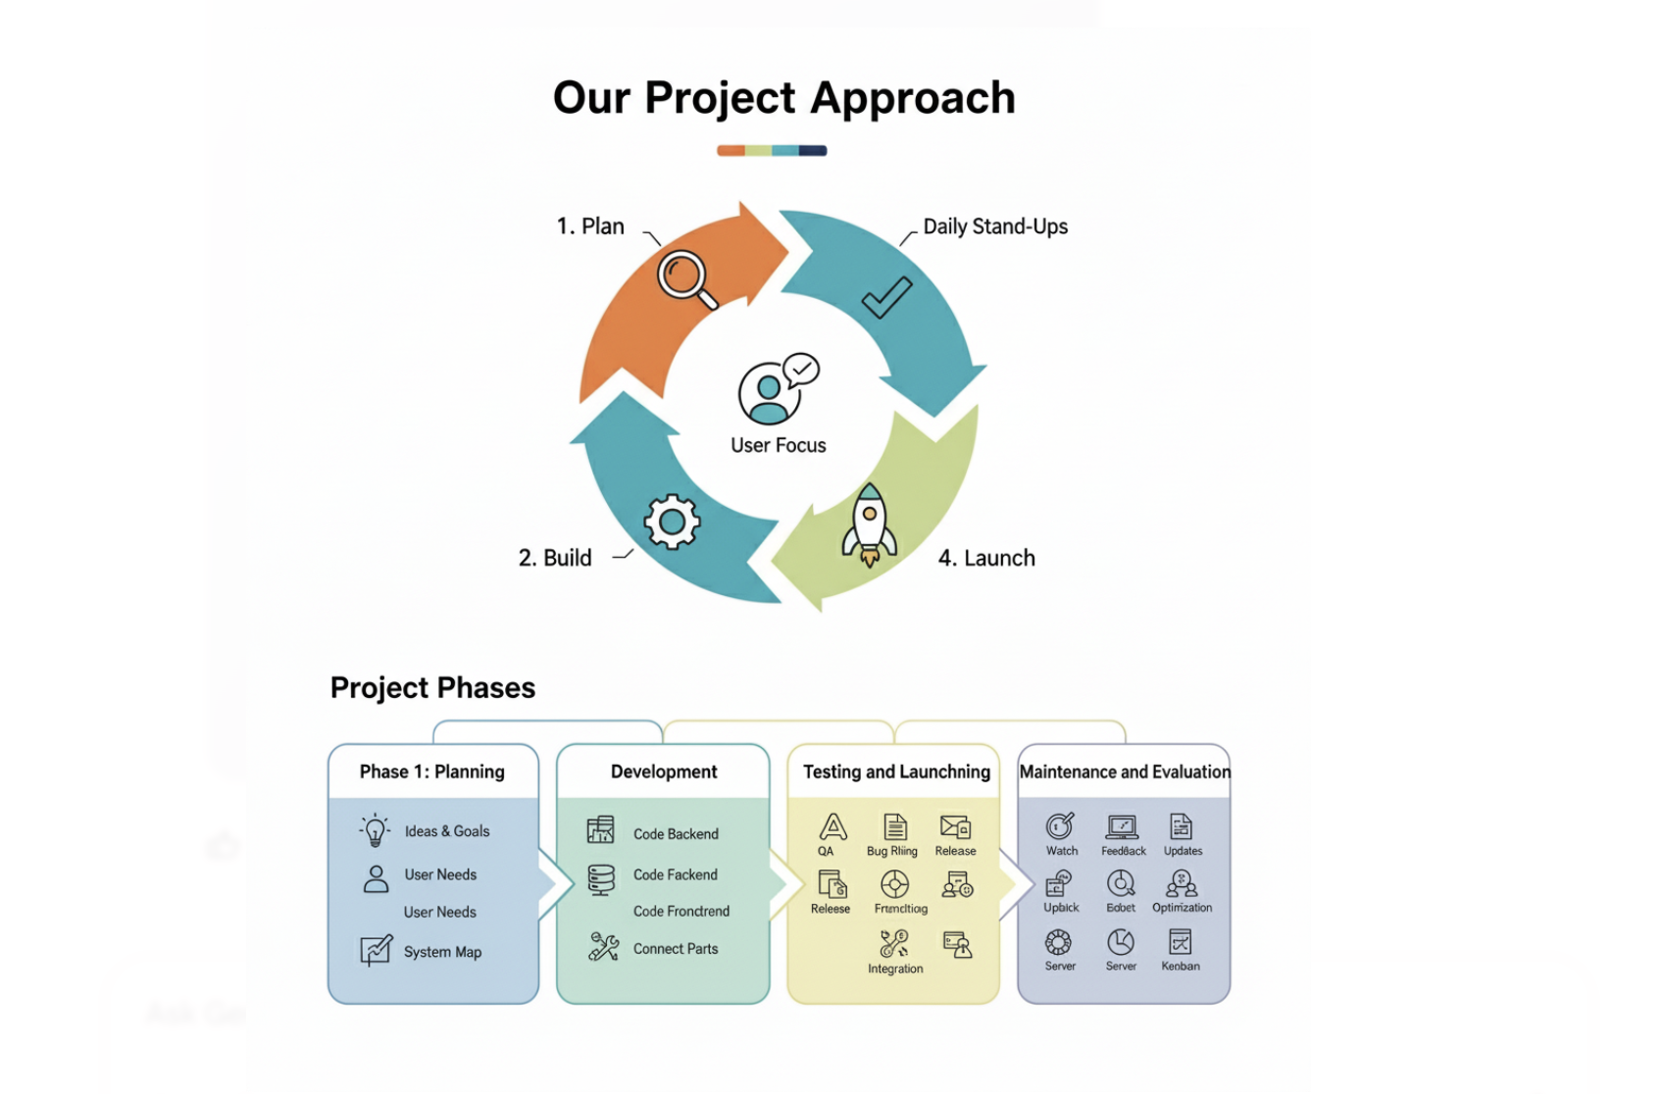
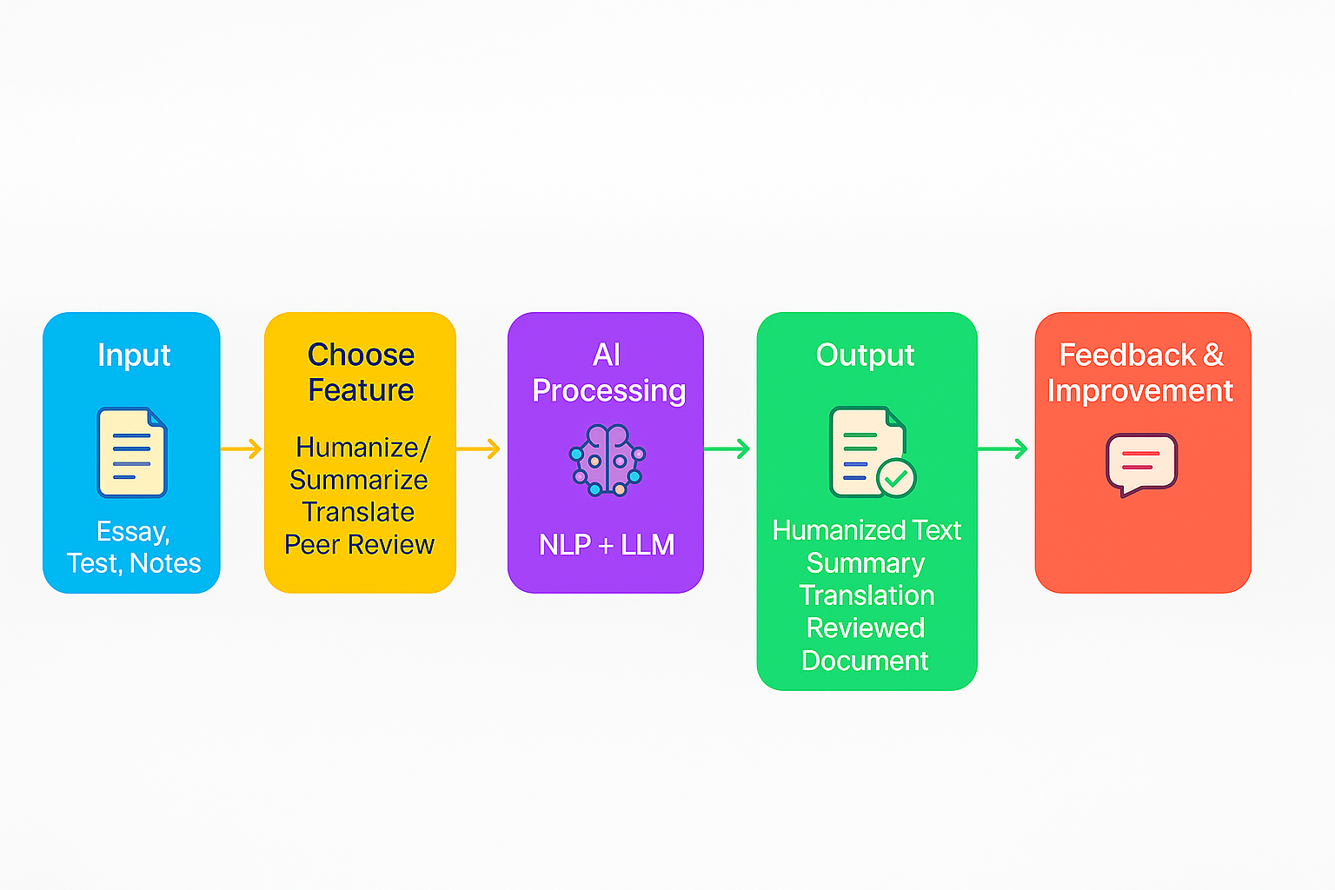
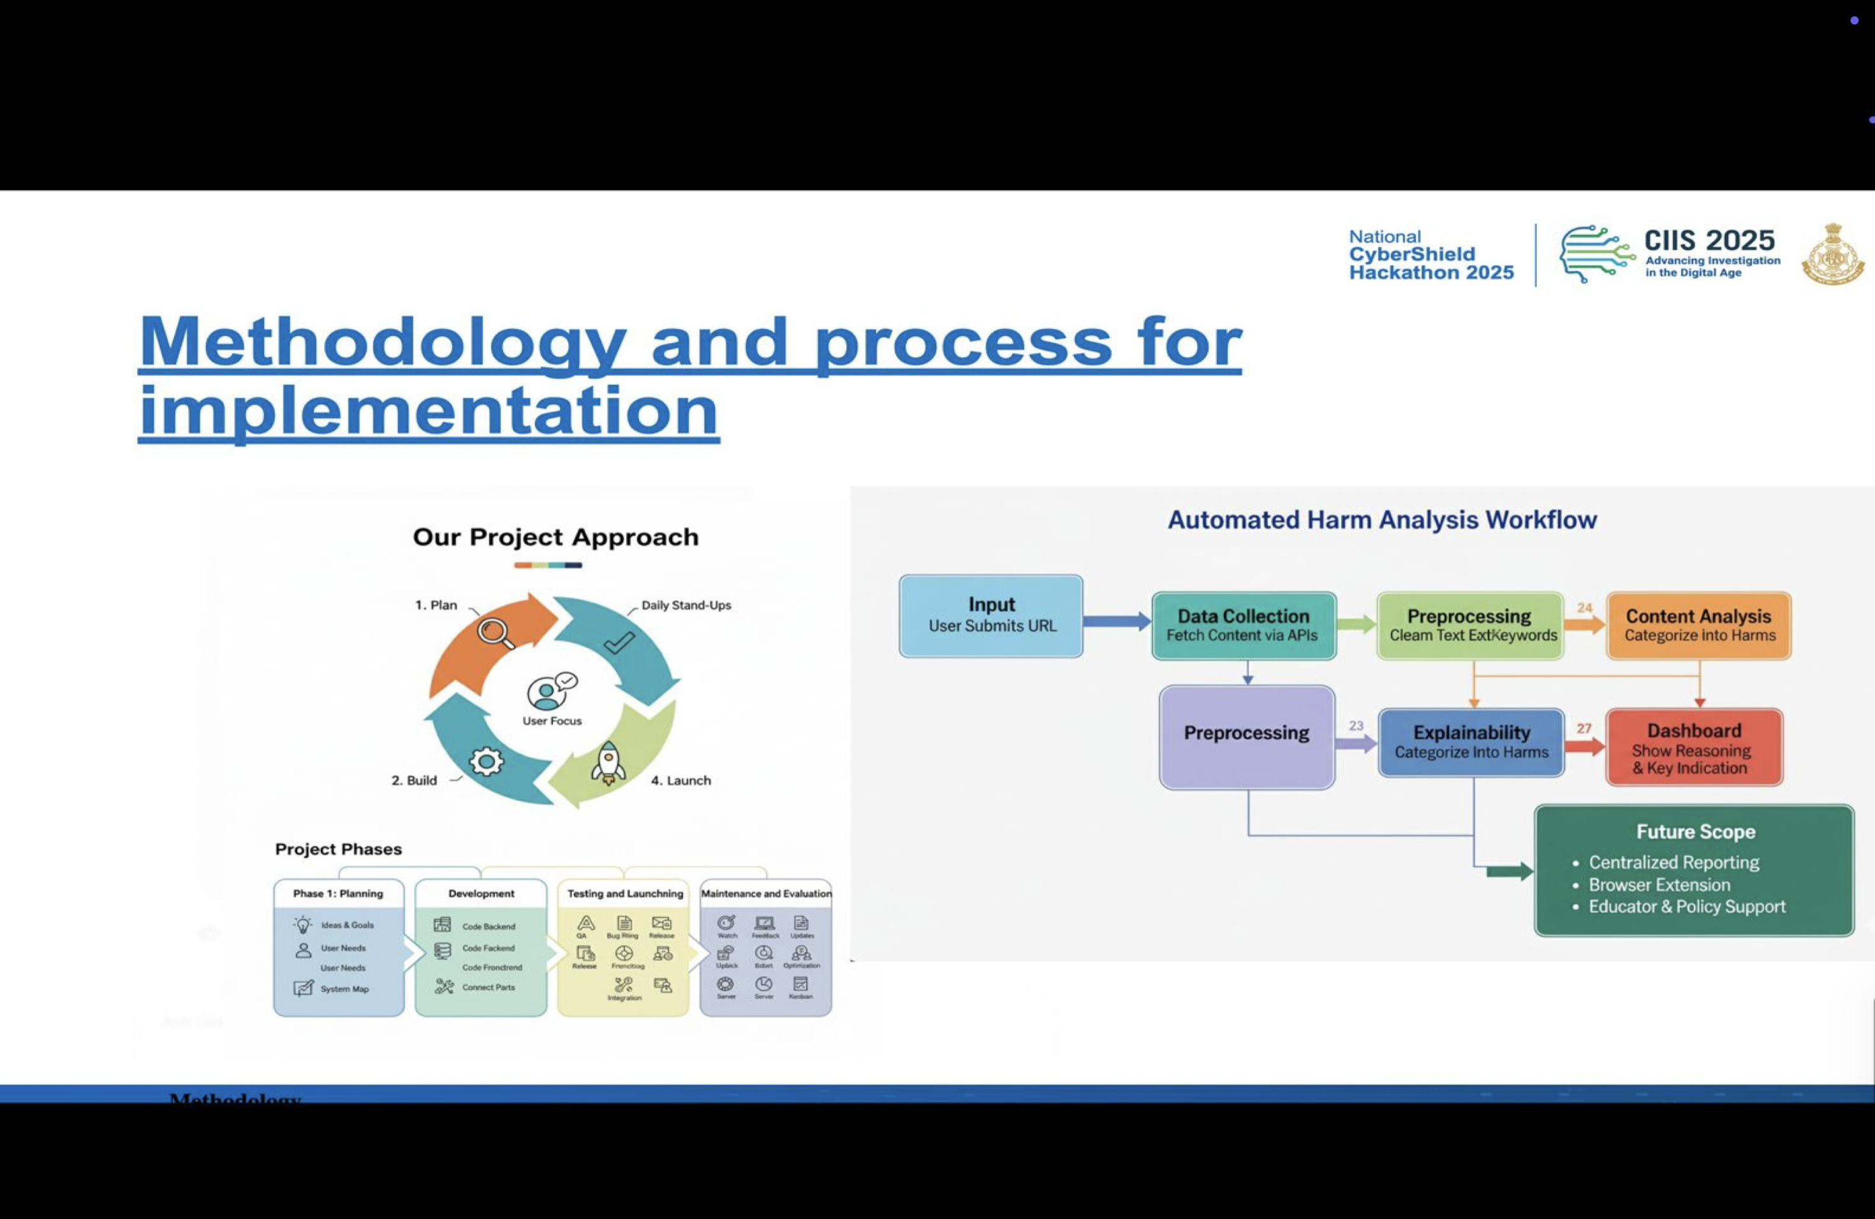
Methodology and Process
Link for prototype-
.

Slide 6
Key Features
1. AI-Powered Assessment – Automated descriptive answer evaluation with NLP & ML models.
2. Text Humanization – Converts raw or complex writing into natural, engaging language.
3. Summarization Tool – Condenses lengthy text into concise, student-friendly summaries.
4. Translation Engine – Multi-language support to enable cross-language learning and communication.
5. Peer Review System – Real-time collaborative editing and feedback among students.
6. Integration with LMS – Seamless integration with existing platforms like Moodle, Google Classroom, etc.
8. Multilingual Inclusivity – Support for diverse learners across different regions and languages.
10. Cross-Platform Access – Available as a mobile app and web application with responsive UI.
.

Slide 7
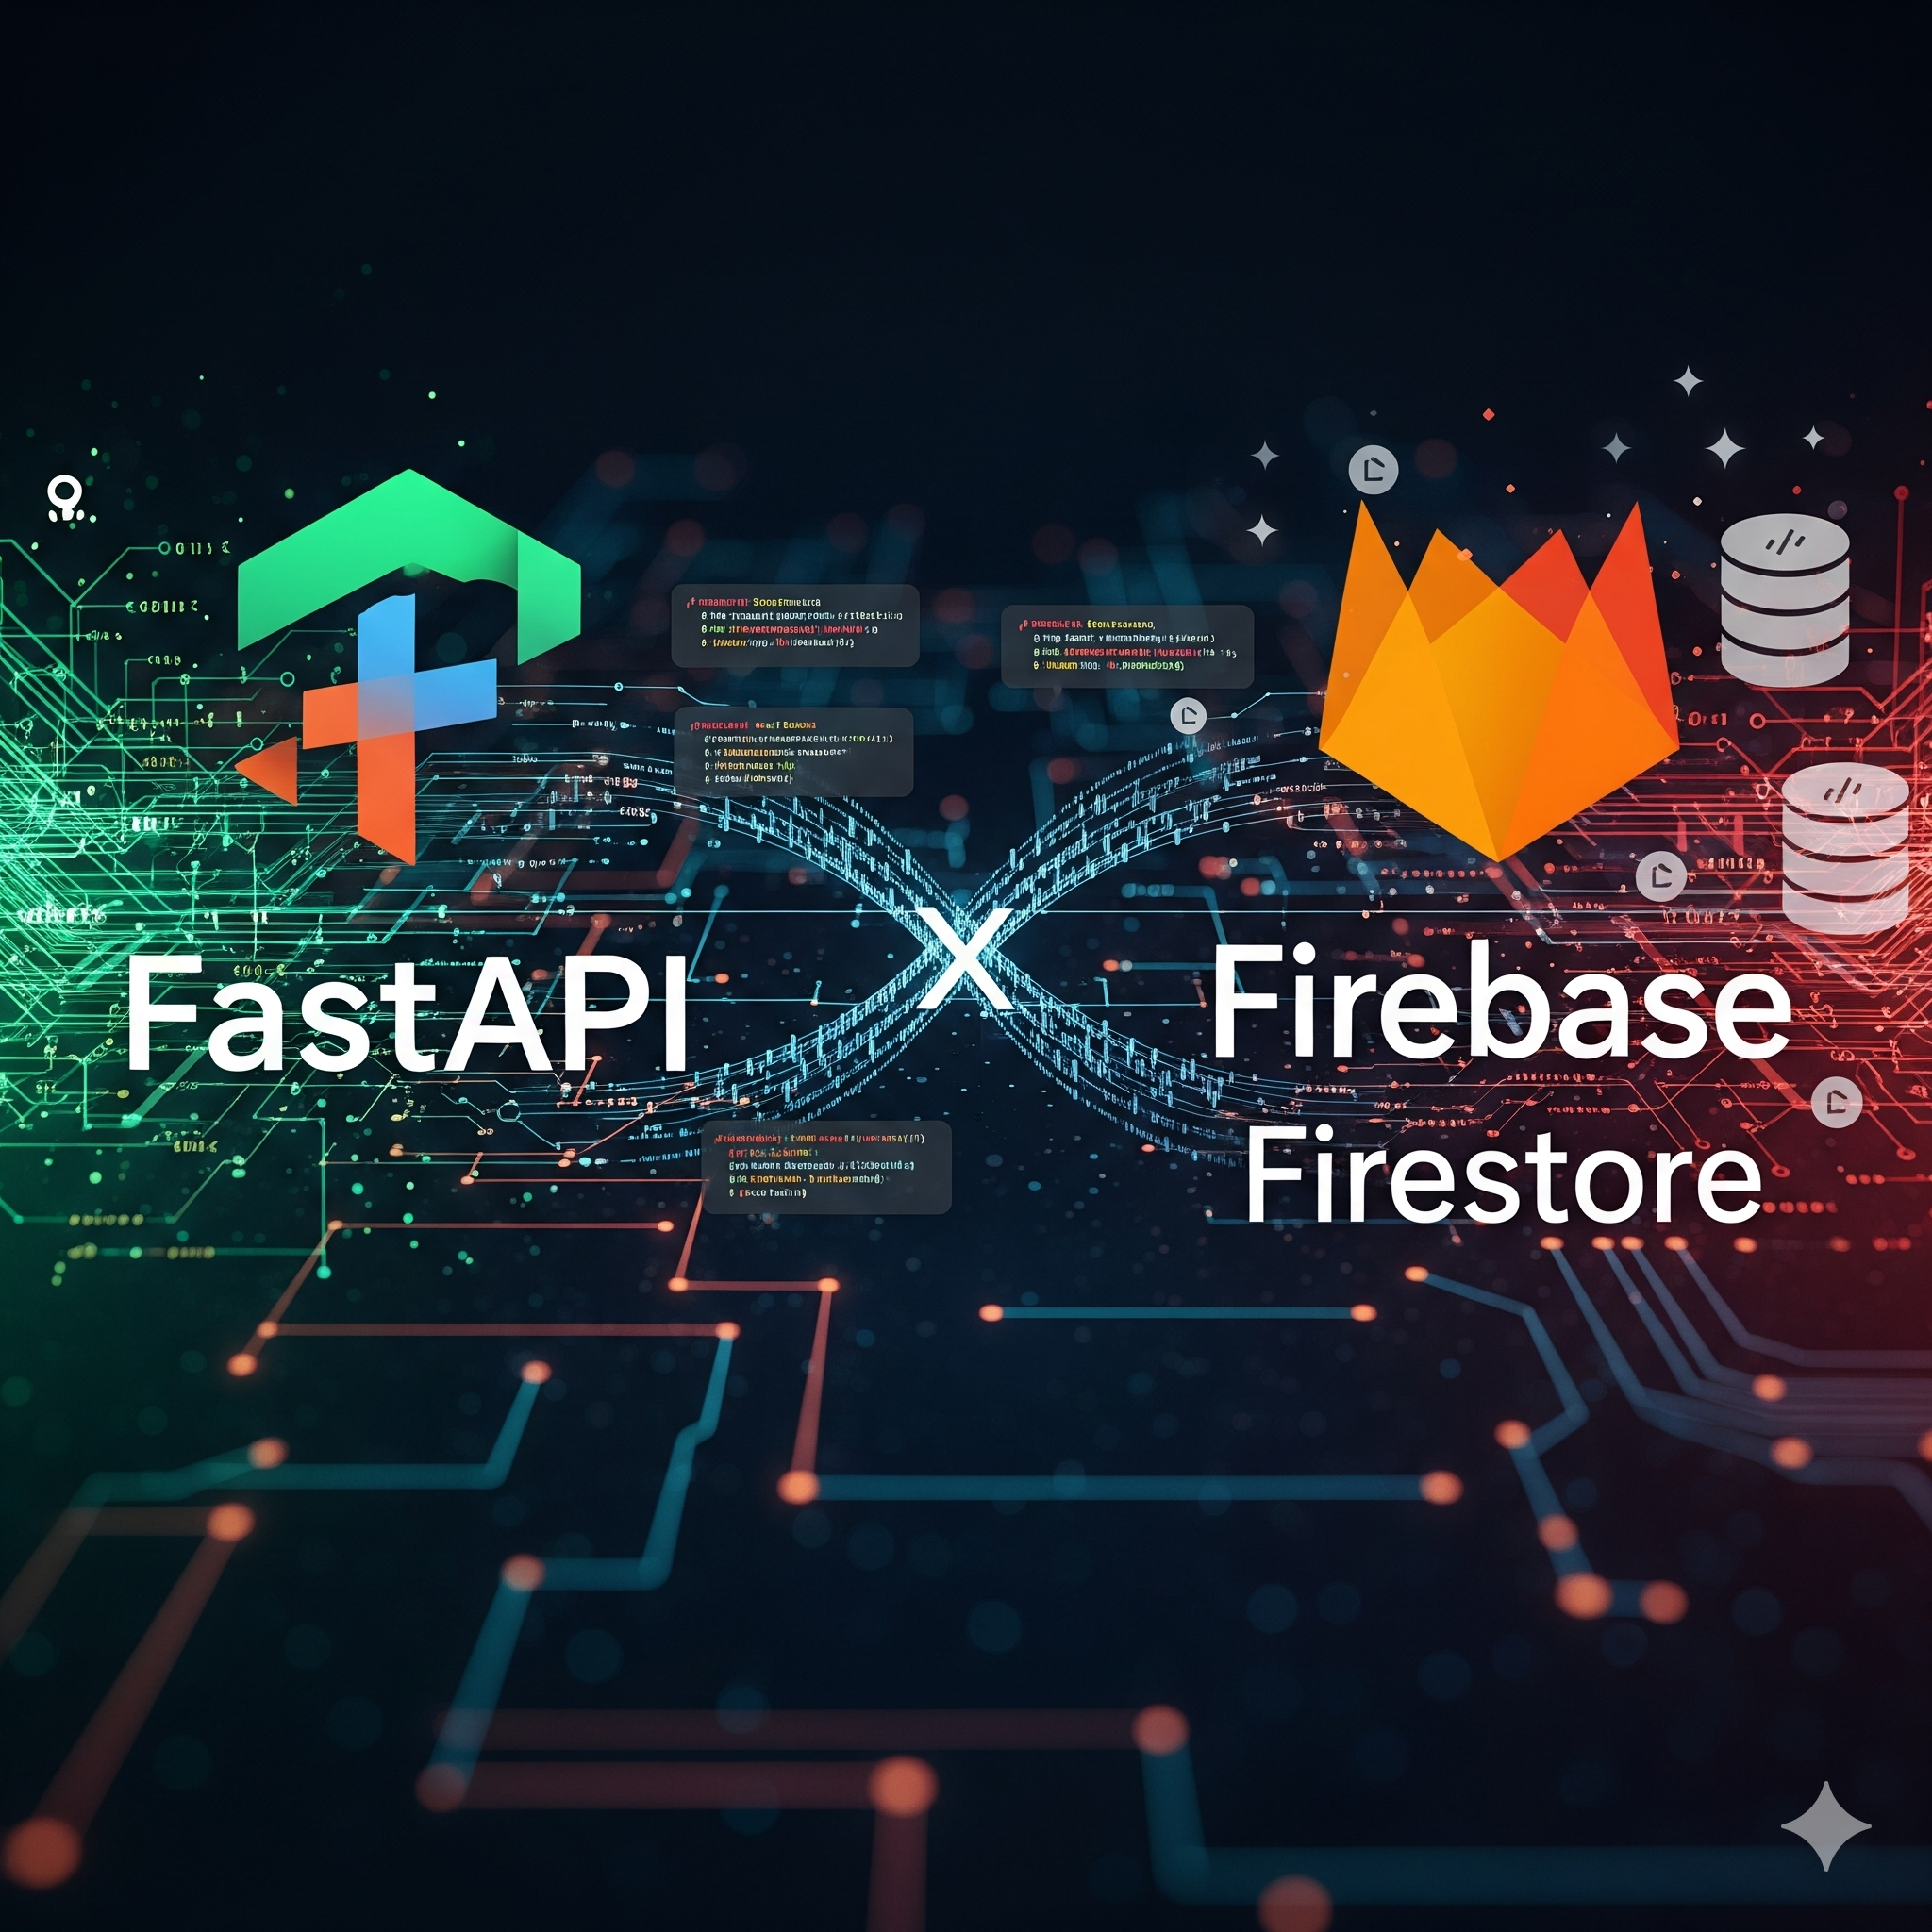
Technical Approach
Backend: FastAPI (Gemini), firebase firestore(Data base)
Frontend: Tailwind, Html, CSS and Java Script
Classification: Keyword-based + NLP

Slide 8
Expected Outcomes
Faster & Fair Evaluation – Reduced manual grading effort, instant feedback for students.
• Improved Comprehension – Summaries and humanized text help learners grasp complex content easily.
• Global Collaboration – Multilingual translation and peer review break communication barriers.
• Scalability – Usable for schools, colleges, and online platforms with large student bases.
• Research Contribution – Adds to the growing field of AI in Education (AIED) with unique integration of assessment + collaboration + inclusivity.
Research & References
AI in Education (IEEE, Springer research papers).
EdTech platforms like Duolingo, Coursera (AI personalization examples).
NLP-based grading systems (automated essay research).

Slide 9
Potential Challenges and Opportunities
Potential Challenges:
1. Data Privacy & Security – Protecting students’ personal and academic data from misuse.
2. Technical Limitations – Requires strong infrastructure (internet, devices, servers) which may not be available everywhere.
3. Cost & Maintenance – Developing and maintaining AI-powered tools can be expensive.
Opportunities:
1. Personalized Learning – AI can analyze each student’s performance and suggest customized learning paths.
2. Instant solution– Students get quick evaluation, helping them improve continuously.
3. Scalability – Can be used for large numbers of students at once, useful for schools, colleges, and online platforms.

Slide 10
Innovation & Uniqueness
Integration with learning management systems.
Combines four essential tools in one platform (rare integration).
Uses AI + NLP models for accurate human-like rewriting.
Provides real-time collaboration for peer reviews.
Supports multilingual education and inclusivity

